Slide 1

nationalgrid
Smart Meter Installation Analysis and Operational Optimization
Prof. Gary LaPoint
Anjana Sowmya Puvvada
Nandita Pathardikar
Umang Vora
Shweta Khopde

Slide 2
About nationalgrid:
National Grid, serves as a key utility provider in the northeastern United States, primarily in New York. The company focuses on the transmission and distribution of electricity and natural gas to millions of customers. Committed to sustainability and innovation, National Grid invests in renewable energy technologies and infrastructure improvements, playing a vital role in the region's energy transition and efficiency enhancements.
About project:
Project Overview: This comprehensive project delves into the deployment of smart meter installations, encompassing both electric and gas modules., as well as a combination of both. The analysis is conducted at the OP Centre, Route and Bill Cycle levels, offering detailed insights into households that are required to be equipped with these advanced meters. The project addresses the unique categorization of houses based on their energy sources—electric only, gas only, or dual-fuel (both electric and gas). Additionally, a key focus lies on optimizing operational efficiency by mitigating the occurrences of "Unable to Complete" instances, where installation activities face impediments. Along with all this, we have also done cost estimation for the meter installations, providing our recommendations to properly navigate through all these problems.

Slide 3
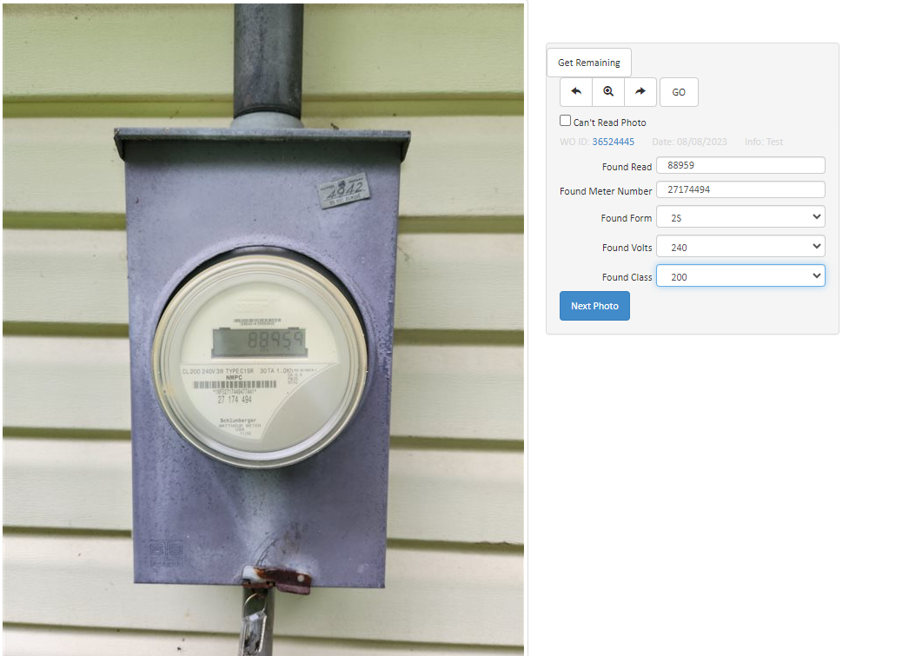
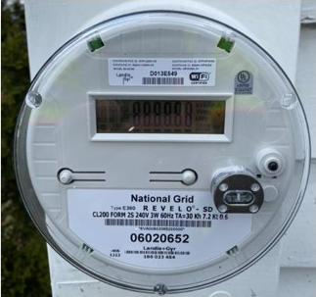
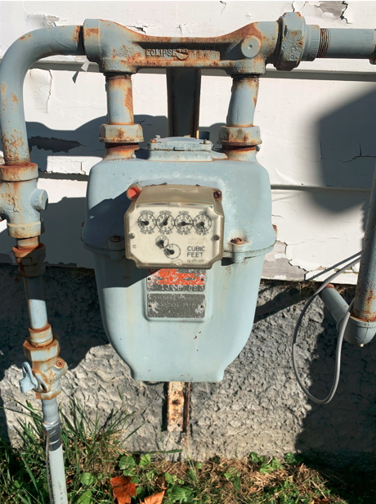
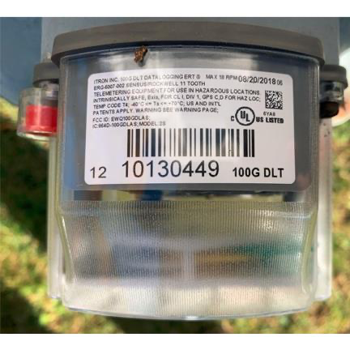
Advanced Metering Infrastructure (AMI) Meters Overview:
AMI meters, commonly known as smart meters, are deployed by utility companies to modernize the electricity and gas metering infrastructure. They offer real-time data collection, remote meter reading, and improved energy management for consumers and utilities. The deployment involves systematic steps such as planning, regulatory approval, vendor selection, deployment strategy development, installation, data management, customer education, testing and maintenance, and ensuring data privacy and security.
Old Gas Meter
New Gas Meter
Old Electric Meter
New Electric Meter

Slide 4
Problem Statements
National Grid and Utility Partners encounter obstacles with delayed Gas Module availability, resulting in costly return visits for Dual Fuel and Gas-only customers. The escalation of UTC rates, in conjunction with an increasing number of customer opt-outs prior to installations, compounds project costs. Installations in overlapping areas becomes critical to optimize resources and enhance operational efficiency from September 2023 to November 2024.
Scope of project:
Analyze Housing Data: Break down the number of houses by type - electricity only, gas only, and dual fuel. This segmentation will help in understanding the scope of the project for each category and planning the installation schedules accordingly.
Evaluate UTC Data: Assess the UTC data to understand the financial aspects of the project. The UTC rates can indicate how costs are fluctuating as the installation progresses, which is vital for budgeting and forecasting.
Assess Resource Allocation with Cost Estimation: Use the data to evaluate the efficiency of resource allocation. Are there areas where the deployment can be made more efficient to reduce the need for return visits? For areas with a mix of electricity, gas, and dual fuel customers, devise strategies to minimize repeat visits. This might involve coordinating installations in a way that optimizes the use of resources and time. Additionally, estimate the cost for these installations.
Review Opt-Out Data: Analyze the data on customers who have opted out of the AMI program. Understanding the reasons behind these opt-outs can inform strategies to address concerns or misconceptions about smart meters.

Slide 5
Communication Timeline
135 Days Prior
90 Days Prior
60 Days Prior
Community education initiatives
Another round of community education.
Mailing to customers
30 Days Prior
10 Days Prior
Follow-up mailing to customers
Email, robocall, phone calls, and texts

Slide 6
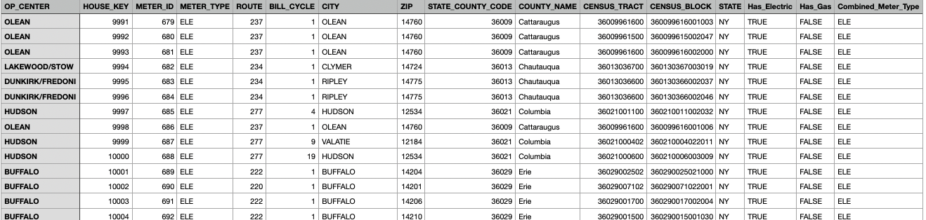
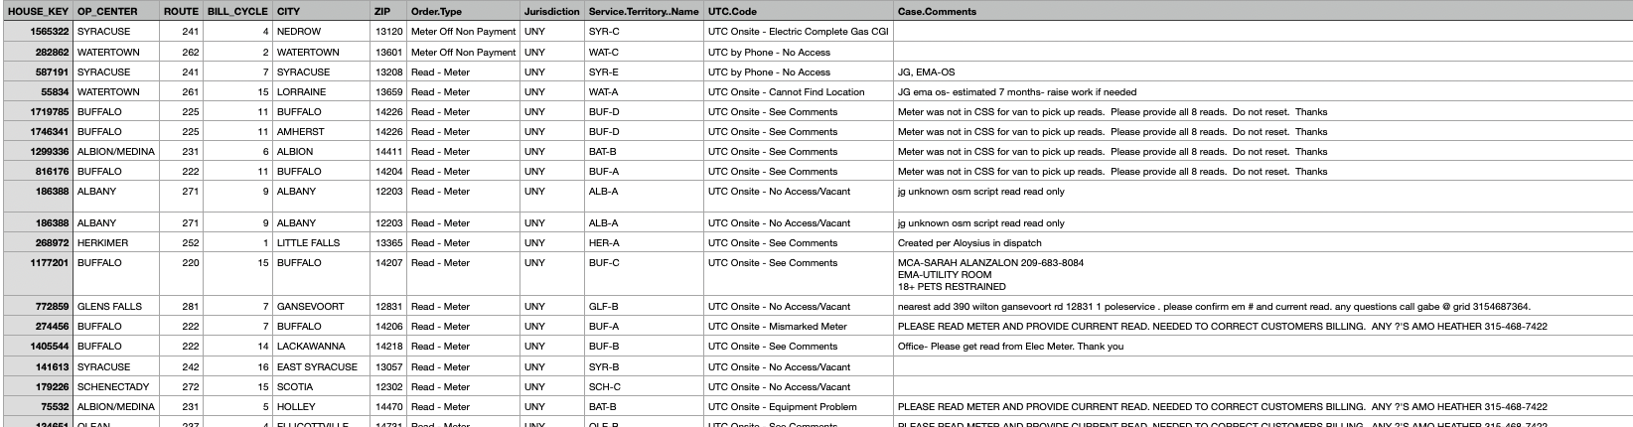
Data Collection
Our team collected 2 types of data separately. Data was collected via SU Sharepoint (MS teams). 1. Premises data set with details about meter distribution for each house: contains unique house keys for each
House, meter type (electric, gas, dual fuel), OP Centre, Route, Bill Cycle, City and Zip code.
2. Unable to Complete (UTC) dataset: a list of premises for which the team was unable to complete the installation, with reasons for not being able to complete it, the house key, zip, OP center, route, bill cycle, zip and UTC type Code.

Slide 7
Data Analysis

Slide 8
Increased UTC Rates
Observed Reasons for UTCs
Majority of UTC Occurrences
No access/vacant houses
Load on meter
Not ready to be installed
Customer cancellation on-site
Customer cancellation on the phone
Cannot find location
No access or vacant houses identified as the primary contributor

Slide 9
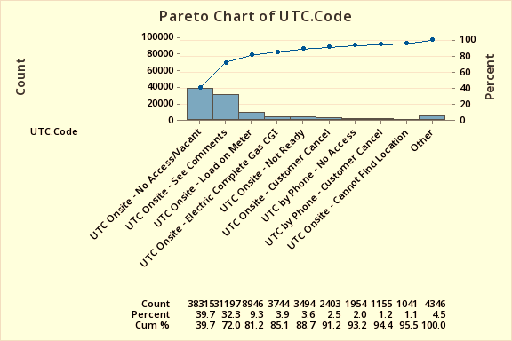
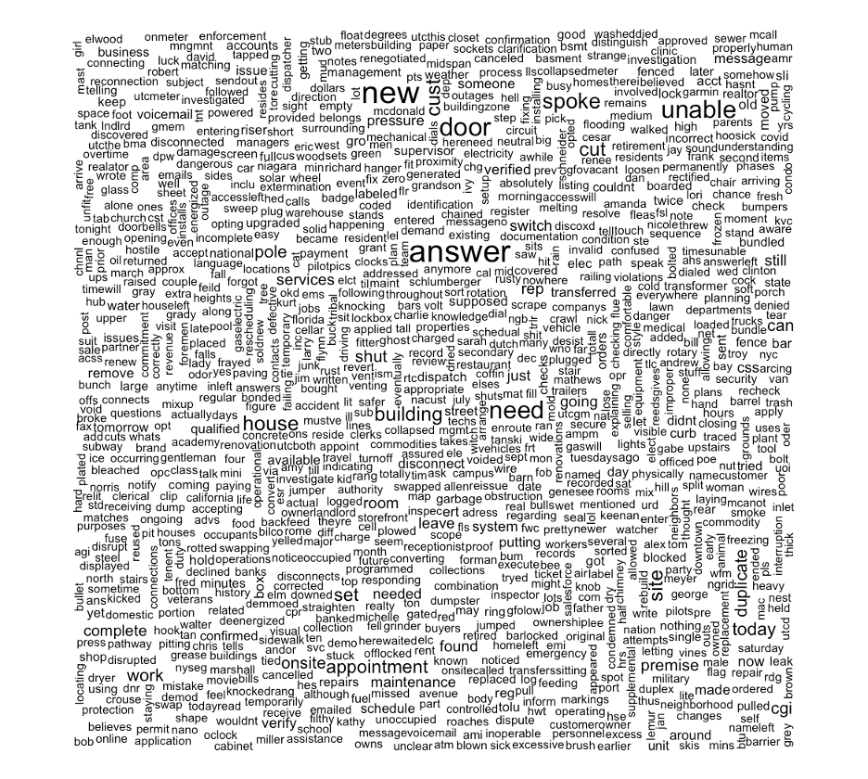
UTC Rates

Slide 10
Communication Content & Customer Behavior Analysis
Opt-Out Increase Near Installation Period
Opt-outs rise as the installation period approaches
Health Concerns Addressed
Addresses common misconceptions regarding health concerns associated with the new meters
Reasons for Opting Out
Personal choice often cited.
Health concerns raised, though scientifically unfounded

Slide 11
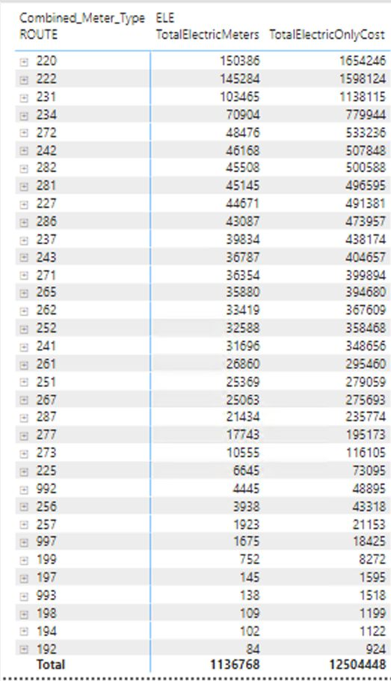
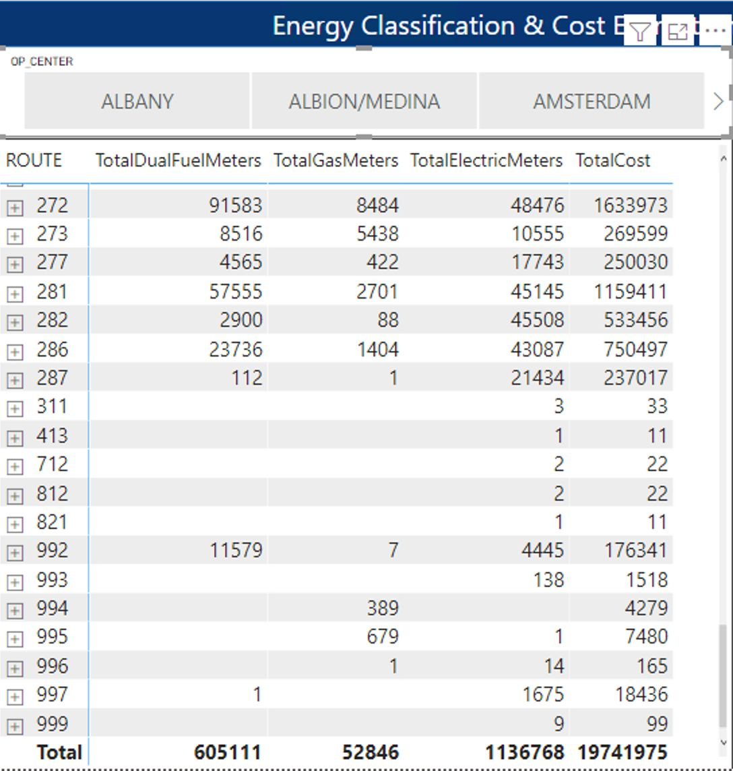
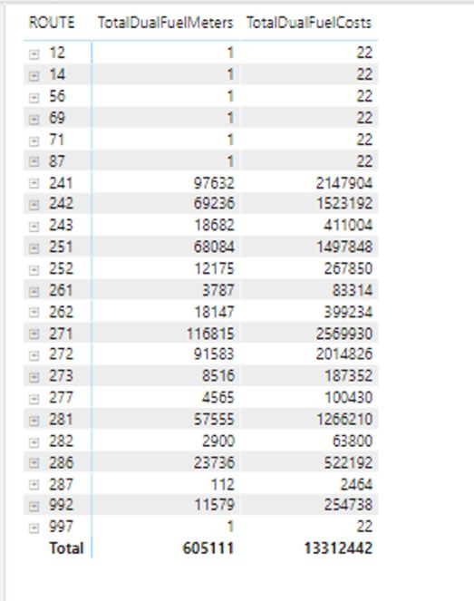
Initial Costs (No Revisits):
Dual Fuel Meters: $6.66M
Electric Meters: $12.5M
Gas Meters: $581K
Total Initial Cost: $19.74M
Costs with Revisits (Due to Gas Module Unavailability):
Additional Cost for Dual Fuel Meters: $13.31M
Total Cost with Revisits: $26.40M
Cost Analysis:
Impact of UTCs and Customer Opt-Outs:
Additional visits due to UTCs and opt-outs increase overall costs
Emphasis on the need for efficient operational planning and customer communication
Visual Elements

Slide 12
Recommendations
Clear and Transparent Cost Communication
Clearly communicate the costs associated with opting out in all communication materials
Use customer-friendly language to explain the financial implications, emphasizing the potential monthly charges for opting out
Assurance of Safety
Reassure customers about the safety of the new meters using easily understandable language
Highlight industry standards and studies supporting the safety of the technology
Loss Aversion Messaging
Frame the communication to emphasize potential losses associated with opting out, such as higher monthly fees
Utilize behavioral economics principles to encourage a more positive perception of the installation

Slide 13
Recommendations
Tailored Communication
Recognize community differences.
Segment by income: Cost savings for lower-income, environmental safety for higher-income. Step-Wise Opt-Out Process
Implement a step-wise opt-out process that requires customers to apply for opt-out
Make the initial opt-out option less accessible, requiring additional steps for confirmation
Incentivize Staying In
Introduce incentives for customers who choose to stay in the program
Emphasize benefits such as potential cost savings, improved services, or access to additional features

Slide 14
Recommendations
Frequent but Brief Updates
Provide ongoing updates in a phased manner, ensuring that customers are gradually exposed to information
Break down complex details and information into manageable segments over the communication timeline
Engaging Visuals
Use engaging visuals and infographics to convey key messages and benefits effectively
Illustrate the potential positive outcomes of staying in the program
Continuous Customer Feedback Loop
Establish a continuous feedback loop to gather insights on customer perceptions
Adapt communication strategies based on customer feedback and preferences

Slide 15
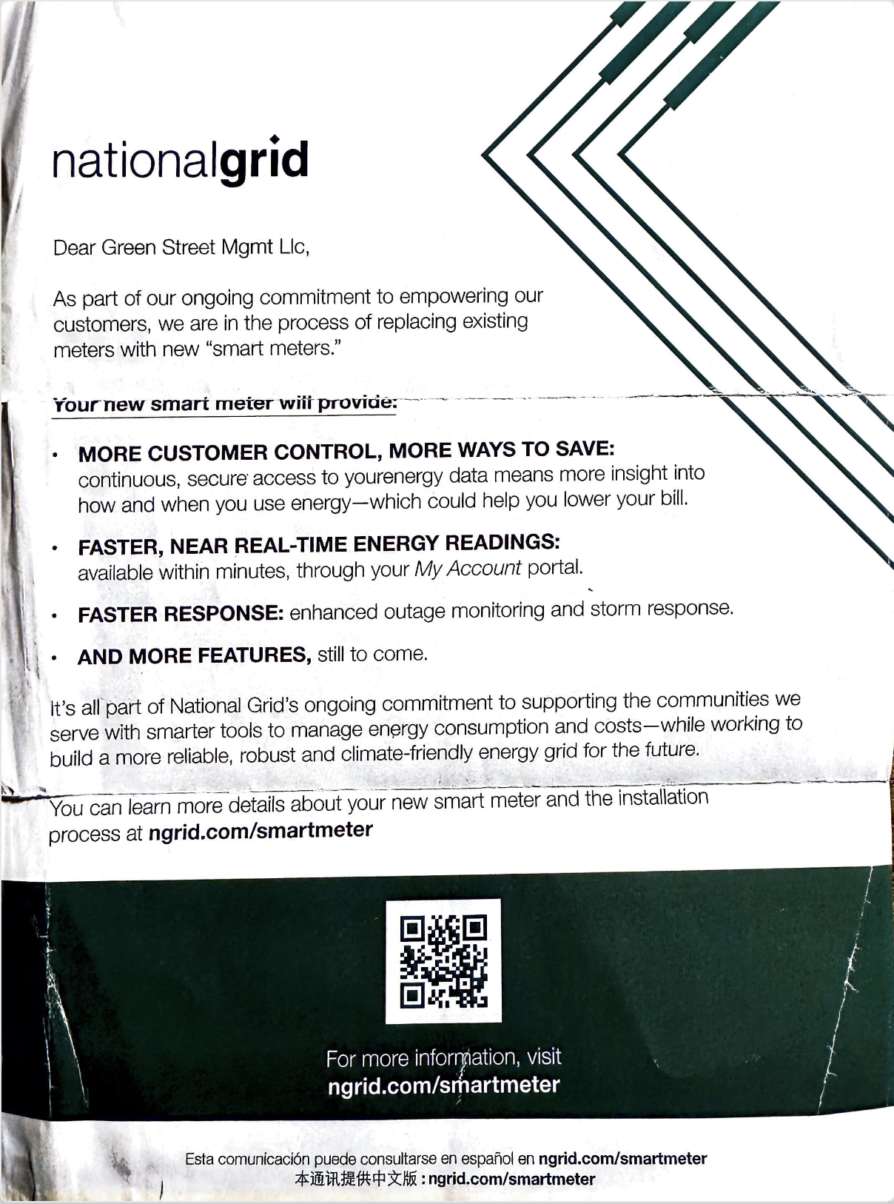
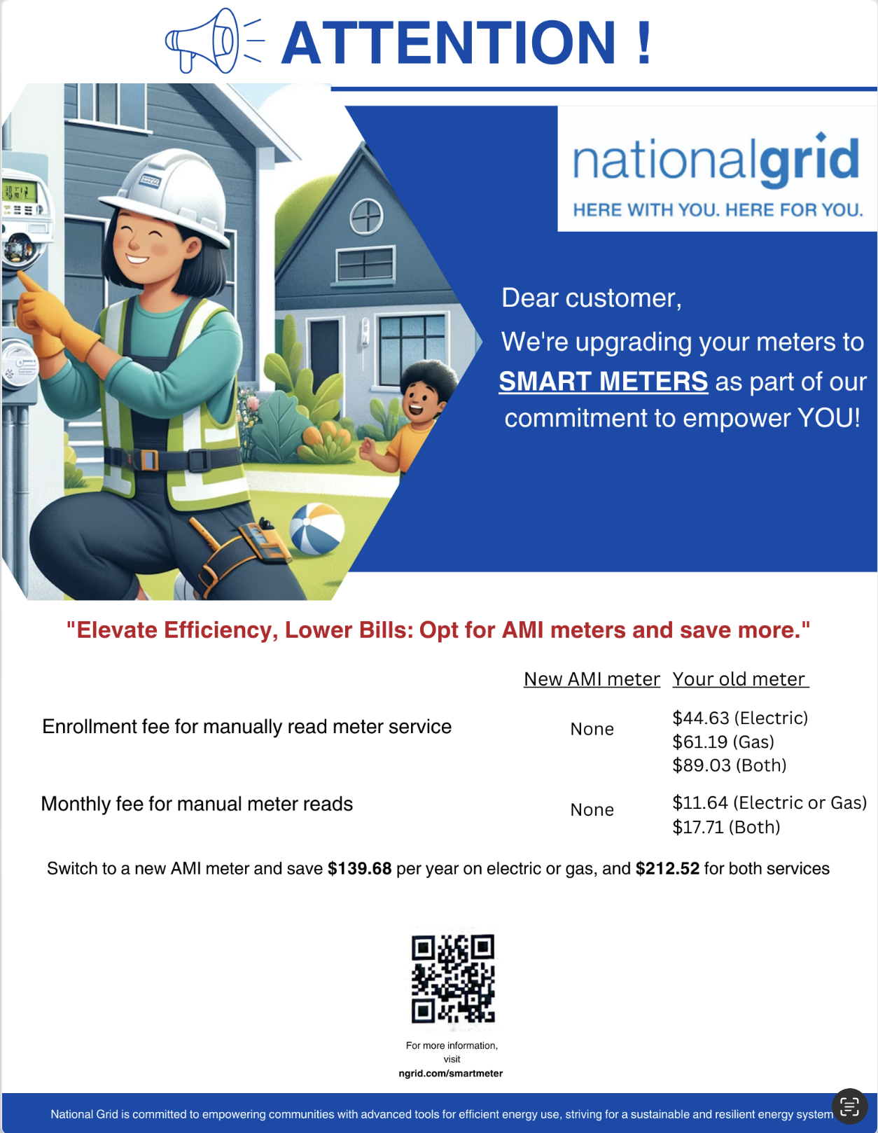
Marketing Recommendation
Original marketing flyer:
Recommended Marketing flyer:

Slide 16
Thank You!

